Slide 1
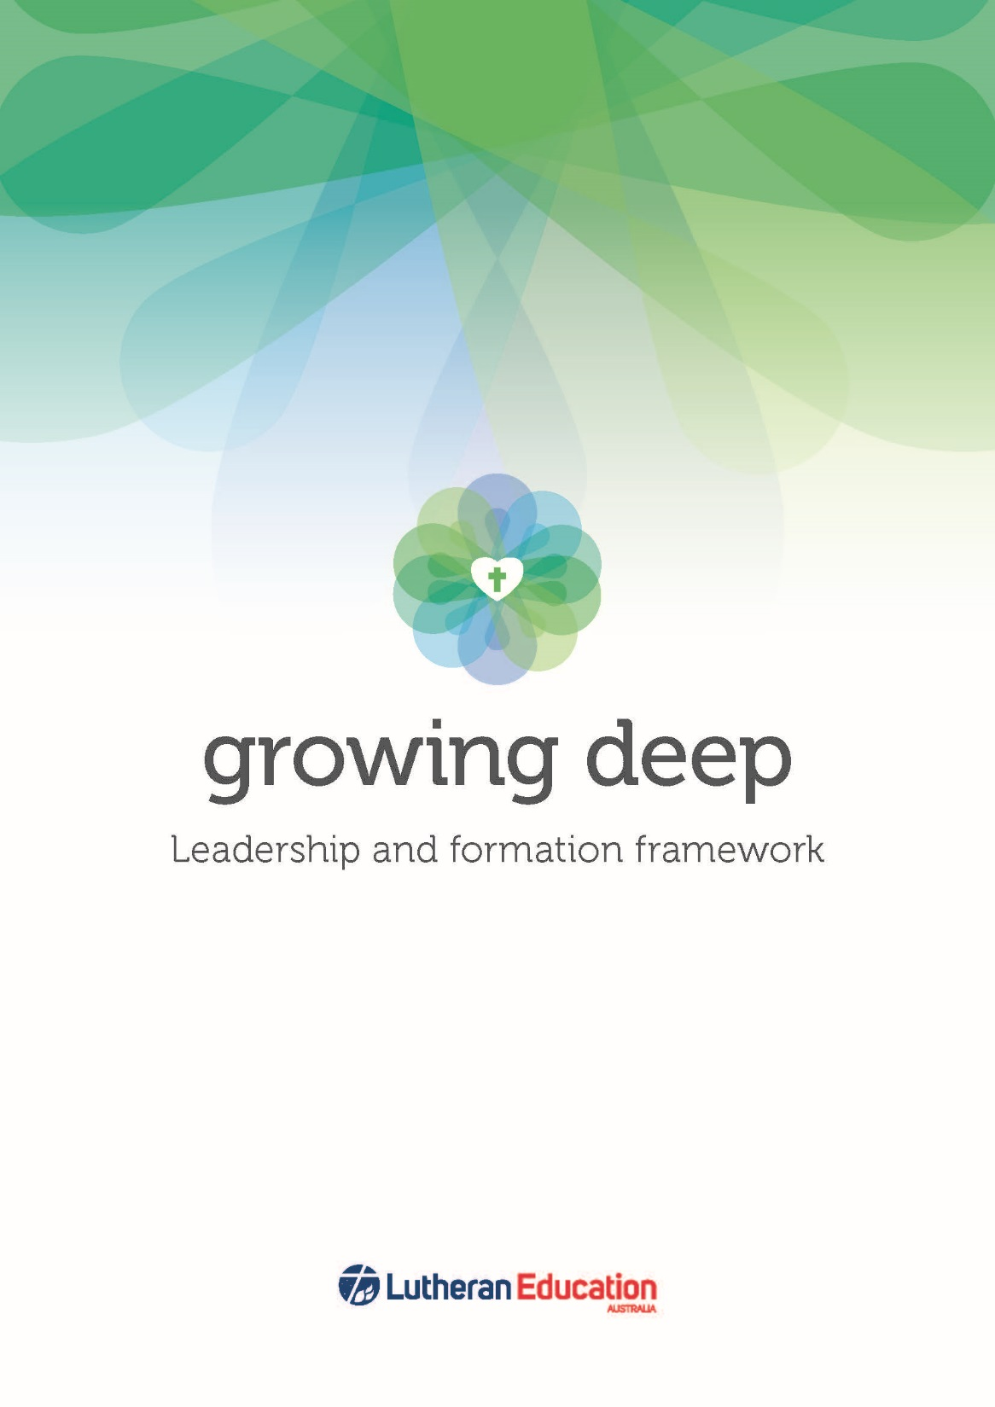
Notes:
Welcome and housekeeping

Slide 2
Devotion

Slide 3
Notes:
Connecting concept of Growing deep to the knowledge and experience of participants.
Ask participants to discuss:
Please reflect upon and then discuss who and what has helped you to grow deep? This can be either personally, professionally or spiritually.

Slide 4
Purposes of the day
For participants to:
become familiar with Growing deep
become familiar with the Growing deep resources
to equip participants to share Growing deep with their communities
to provide time for participants to plan for the roll out of Growing deep
to discuss ways LEA and regions can support the implementation of Growing deep in your school or early childhood service.

Slide 5
Plan for the day
Vision for Growing deep
Leadership and formation – unpacking these concepts
The elements of Growing deep
Resources for Growing deep
Growing deep in my school or early childhood service
Regional and national support for Growing deep

Slide 6
Why Growing deep?
Purposes of Growing deep
Notes:
Guide participants to the LEA website http://www.lutheran.edu.au/ to find the Growing deep tab.
Then to the purposes for Growing deep under the home tab.
http://host2.lca.org.au/~growingdeep/home/purposes-of-growing-deep/
Ask participants read and ask for comments or questions.
Discuss: What were the issues Growing deep was intended to address?

Slide 7
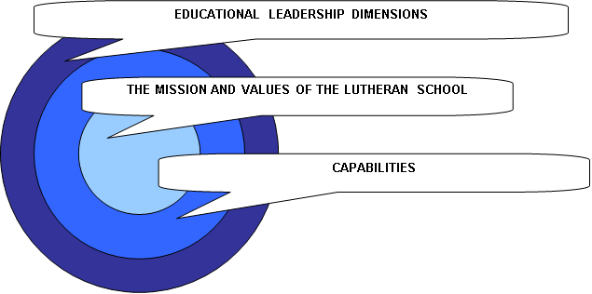
Why Growing deep?
leadership framework needed review
no formation framework
formation and leadership working parties determined one framework
Notes:
Original Leadership framework developed in collaboration with Catholic colleagues and became the basis upon which many Catholic diocese based their frameworks in the 1990s and early 2000s. However it spoke into the context of the principal as leader and was principal-centric.
In 2013, LEA expressed a need for foundational documents describing leadership and formation in Lutheran education.
Shane Paterson met with the Catholic Melbourne diocese and studied a range of Leadership frameworks from Australia and around the world to consider best leadership frameworks.
Anne Dohnt met with Catholic Formation directors in the Brisbane, Melbourne and Adelaide diocese to consider their Formation frameworks.
After considering these different frameworks the Formation and Leadership working parties met and decided that formation was integral to leadership and that one framework would describe both leadership and formation in Lutheran education.
The Regina Bechtle article was a key reading at this meeting.
Decision for one framework
Rationale: Spiritual formation is at the heart of Lutheran schools and is critical for leaders in our schools
Need a leadership framework that has a clear central premise that has to do with the formation of leaders over development of skills alone ..

Slide 8

Executive Director: Stephen Rudolph introduces Growing deep
Notes:
Show the Introduction to Growing deep video

Slide 9
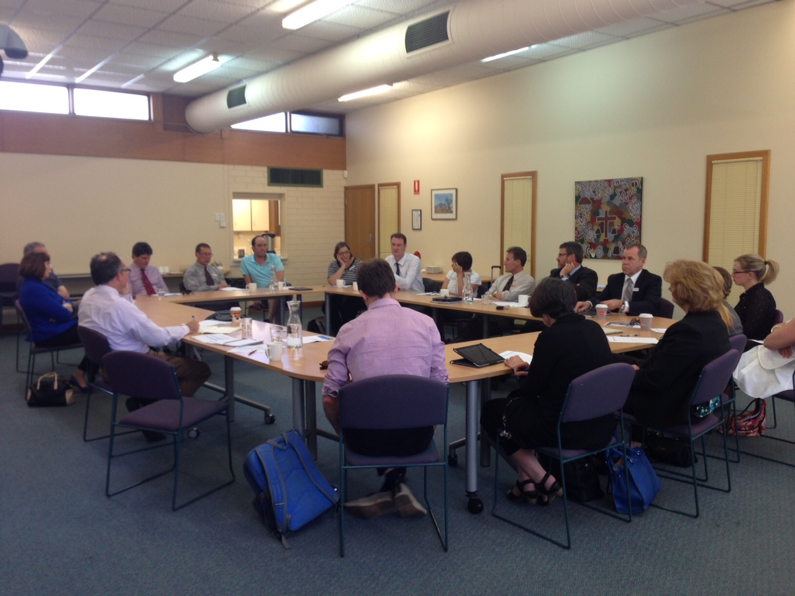
A collaborative effort…
Atkinson-Consulting! consultations captured the voice of leaders, teachers and staff.
2014 – Consultations with over 120 school,
regional and national leaders.
2015 – Validations
2015 – Trial of the Framework
2016 – Launch of the Framework
Notes:
Atkinson-Consulting! facilitated independent consultations in each region that captured the voice of executive leaders, principals, teachers and staff as they described their work and what was needed for the future.
The consultations ensured that the framework is shaped by and reflects the language of Lutheran educators, including principals, teachers and staff.
2014 – Consultations with over 120 school, regional and national leaders.
2015 – Validations
2015 – Trial of the Framework
2016 – Launch of the Framework will occur collaboratively with national and regional staff involvement. Regions are in the process of finalising dates for Term 1, 2016.

Slide 10
Growing deep connects with:
LEA strategic plan
  strengthen Lutheran identity
  enhancing and celebrating thriving learning communities
  Sustainability
  LEVNT/LSA/LEQ
  strategic initiatives
Notes:
LEA speaks to their strategic plan
Share how the regional strategic plan connects with the NLT/LEA Strategic plan.
How can Growing deep support the initiatives of the regional strategic initiatives?

Slide 11
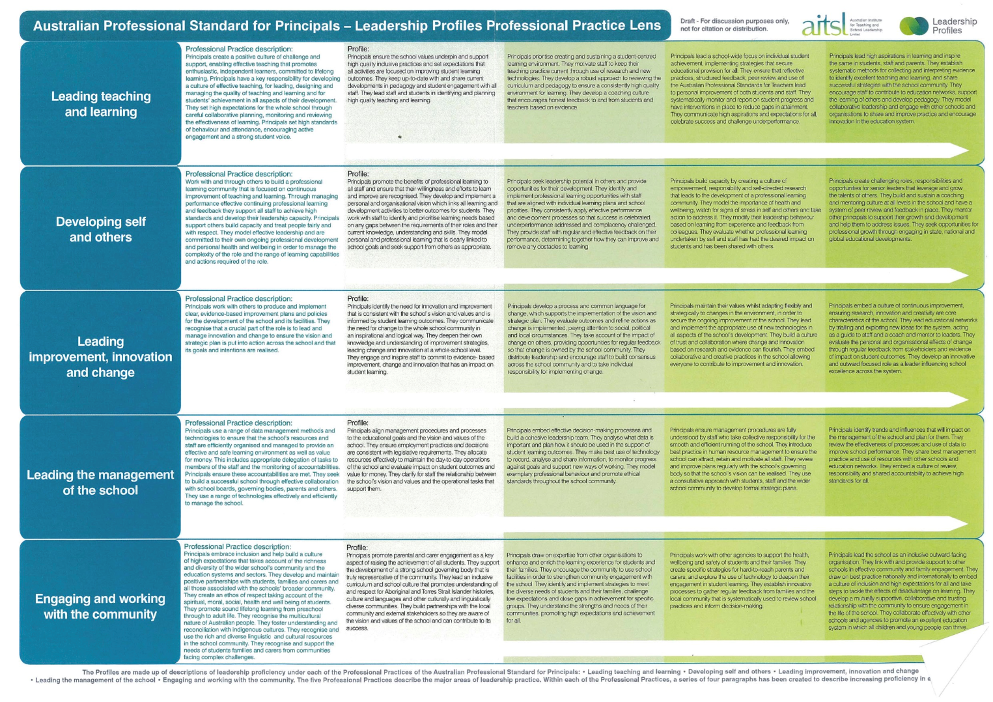
Leadership and formation framework for Lutheran education
Capabilities – “HOW” leaders do what they do
Our Foundation
Growing
oneself
Engaging the community
Leading the team
Focusing on outcomes
Our workplace
culture
Excellence in outcomes
Excellence in learning
Building self awareness
Deepening faith
Learning and adapting
Living positively
Modeling integrity
Listening & understanding
Building support
Networking & strategic relationships
Creating purpose & clarity
Nurturing faith
Growing capacity
Inspiring excellence
Searching for knowledge
Sharing for improvement
Thinking strategically
Making it happen
Ongoing improvement
& innovation
Strengthening
Lutheran Identity
Core Areas of Work – “WHAT” leaders do
Community
building
Leading effective organisation
& management
Notes:
Leadership and formation framework brief
Clearer requirements for our work emerged. Whatever is produced must:
1. Be a foundational document that aligns and simplifies;
2. Align with existing Lutheran (and other e.g. AITSL) documents;
3. Be respectful and considerate of recent past work in this area;
4. Be flexible in form and usable on a number of levels (individual, team, region etc.);
5. Allow for leadership capability to be “immersed” in Lutheran spirituality;
6. Use language that is inclusive (not exclusive) to all in schools settings, including non
Lutherans – it must “speak to many”;
7. Be future focused but meeting leaders where they are at; and
8. Assist with emerging strategic challenges such as leadership development, leadership
Succession within and across the three regions. There is a need to carefully “balance” a
Range of needs to maximise the utility of this work. It needs to be “yes, AND”

Slide 12
Leadership and formation framework for Lutheran education
Capabilities – “HOW” leaders do what they do
A vision for learners and learning in Lutheran schools
LCA and its schools
Our Foundation
Excellence in outcomes
Growing
oneself
Engaging the community
Leading the team
Focusing on outcomes
Our workplace
culture
Excellence in learning
Building self awareness
Deepening faith
Learning and adapting
Living positively
Modeling integrity
Listening & understanding
Building support
Networking & strategic relationships
Creating purpose & clarity
Nurturing faith
Growing capacity
Inspiring excellence
Searching for knowledge
Sharing for improvement
Thinking strategically
Making it happen
Ongoing improvement
& innovation
AITSL professional standards for principals
Strengthening
Lutheran Identity
Vocational practices – “WHAT” leaders do
Community
building
Pathways
Leading effective organisation
& management
Equip
AITSL professional standards for teachers

Slide 13
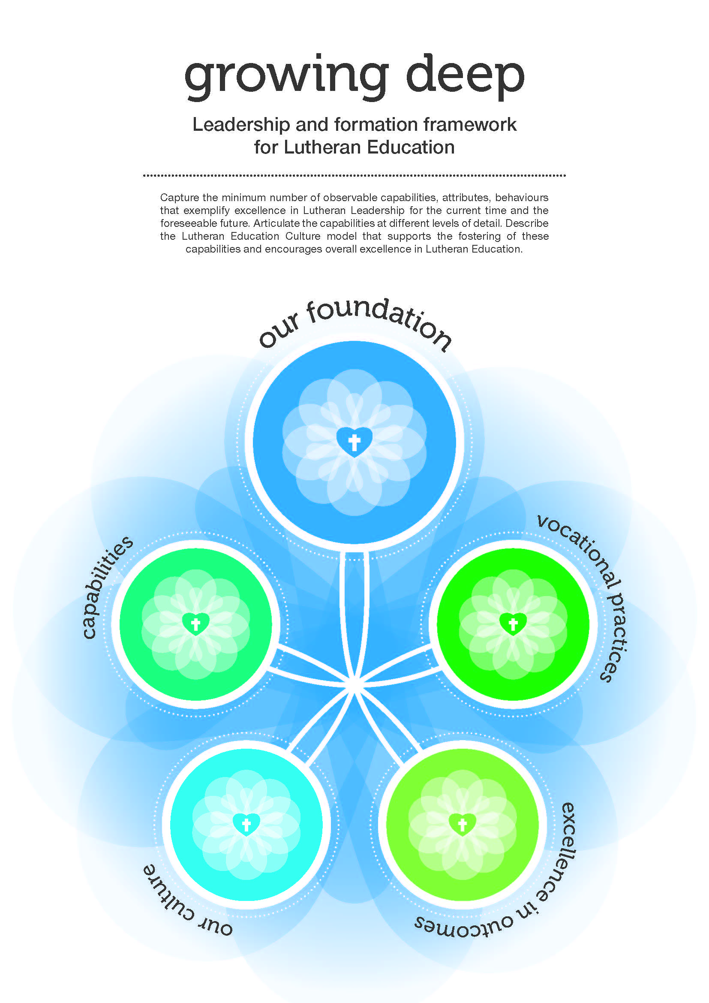
Notes:
Share video of elements
Lutheran schools draw their identity from the way in which Lutheran theological perspectives inform what it means to be a school or early childhood service. In Lutheran education all dimensions of school life are viewed through the lens of Lutheran theology and spirituality.
The Framework captures the work of all members of the school community. It is a dynamic document that has both communal and personal significance. It will inform, clarify and inspire individuals and schools. While the Framework informs leadership practices in all Lutheran schools, each school will give expression to the Framework in ways that reflect their context.

Slide 14

Notes:
Growing deep provides the opportunity to grow and develop our philosophy of leadership and formation. The first part of the launch workshop will build this platform before we look at the elements of the framework.
The Parker Palmer article and the work of Alma Harris has been critical in shaping the leadership platform.

Slide 15
Notes:
I see, I think, I wonder
What does this say to you about Leadership?

Slide 16
Alma Harris video think pair share
How do Alma’s ideas and research about leadership connect to your understanding and experience of leadership?
Notes:
Shane
Alma Harris video
https://www.youtube.com/watch?v=rn8tFU8hQ60
Use the video to highlight that school improvement requires unleashing the leadership capacity of all individuals within the community.
Future leadership will be concerned primarily with participation and relationships rather than leadership skills, competencies or abilities.
Future leaders will be spread across the organisation, and will constantly nurture and fuel new knowledge, new ways of knowing and new ways of doing.
Harris
Transforming leadership is enabling. The leader engages with people in a way that transforms their relationship; they are no longer the leader and the led in the authoritarian sense. They become partners in the pursuit of a common goal, each making their appropriate contribution and increasing their capacity to perform.
Modassir

Slide 17


Leadership
‘Leadership’ is a concept we often resist. It seems immodest, even self-aggrandizing, to think of ourselves as leaders. But if it is true we are made for community, then leadership is everyone’s vocation, and it can be an evasion to insist that it is not. When we live in the close knit ecosystem, called community, everyone follows and everyone leads.
… I lead by word and deed simply because I am here doing what I do. If you are also here doing what you do, then you also exercise leadership of some sort.
Parker Palmer
Notes:
Share quote
Highlight that Growing deep is built upon the concept that everyone is a leader within a Lutheran school within their sphere of influence.

Slide 18
Leadership
What do I need to do for leadership to be a more collective, shared and distributed activity within my school or early childhood service?
In what ways do I have opportunity to lead in my interactions with others?

Slide 19
Formation
What is formation?
Notes:
Ask for participants to reflect on the concept of formation:
Through the ideas shared highlight:
We are all being formed by someone, something, family, work. Formation is about our shaping and forming… it is about who and what shapes us..
Business recognises that who you are is just as important as what you do with Formation programs occurring increasingly to align the beliefs and values of the company with that of the individual. It is not just what you do that is important but who you are.
Formation in Lutheran education relates to the personal, communal, professional and spiritual formation.
That shaping of who we are, in Christian schools particularly relates to the spiritual.
As Christians we are shaped and formed by a God who loves us too much to leave us the way we are. A God that wants to liove us into the people he created us to be.
If we as Parker Palmer says .. We lead who we are… then formation and leadership are interconnected…

Slide 20
Spiritual formation in a Christian tradition answers a specific human question: ‘What kind of person am I going to be?’ It is the process of establishing the character of Christ in the person. That’s all it is….
The most important thing in your life is not what you do; it’s who you become. That’s what you will take into eternity. You are an unceasing spiritual being with an eternal destiny in God’s great universe.
Dallas Willard
Notes:
Resources:
Parker Palmer
Tom Christenson SchooLink article July 2006

Slide 21
We have to realise that spirituality is not just some vague 'feel-good' emotion, but that it grows out of a strong sense of identity, of knowing who I am and what I stand for and believe.
[For Christians] … it means living the life of faith through the power of the Holy Spirit, with our head and our hand as well as our heart.
Bartsch 2006
We lead who we are.
Parker Palmer
Notes:
Formation in Lutheran education is Lutheran in its orientation.
What does that mean?
Read the excerpt from Rob Bell’s The Velvet Elvis that describes the legacy of Luther. Did you know that the Lutheran legacy is about the ongoing process of reforming and repainting the Christian faith so Jesus can be know.
Being innovative is a part of the culture of Lutheranism, whether it be in relation to the Christian faith or education.

Slide 22
Formation
When people enter a Lutheran school or early childhood service, they enter a space where formation will be a part of their experience.
The formation we are talking about is ….
a deeply personal and radically communal pursuit
finds connecting points to the individuals story and offers some new and challenging lenses through which to understand and frame that story
engages the head, heart and hands
ongoing – the nature of journey, everyone on different points on the journey
occurring both within and beyond the school or early childhood service context and is a joint responsibility between the individual, the school or early childhood service and the system
Lutheran in its orientation –reforming
a part of professional learning and not as an adjunct to core business
Notes:
We would hope that a statement like this might appear in appointment letters.
Different statements about formation are displayed around the room. Choose one that is important or challenging for you.
Discuss with someone near you: Why you chose it? What do these statements mean for the formation that might occur at your school or early childhood service?

Slide 23
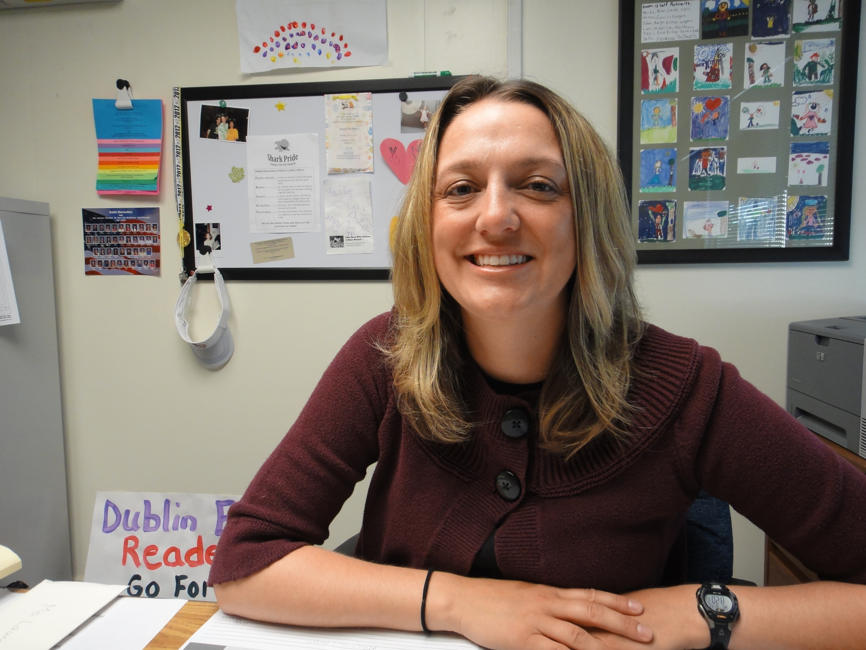
If it matters to you then it will matter to them.
Notes:
The literature consistently indicates that if principals do not see spiritual formation as central to Lutheran education, in overall staff development and in their own leadership, then it is highly unlikely that staff will develop this perspective.

Slide 24
Notes:
In this section we will explore the different elements of Growing deep.

Slide 25
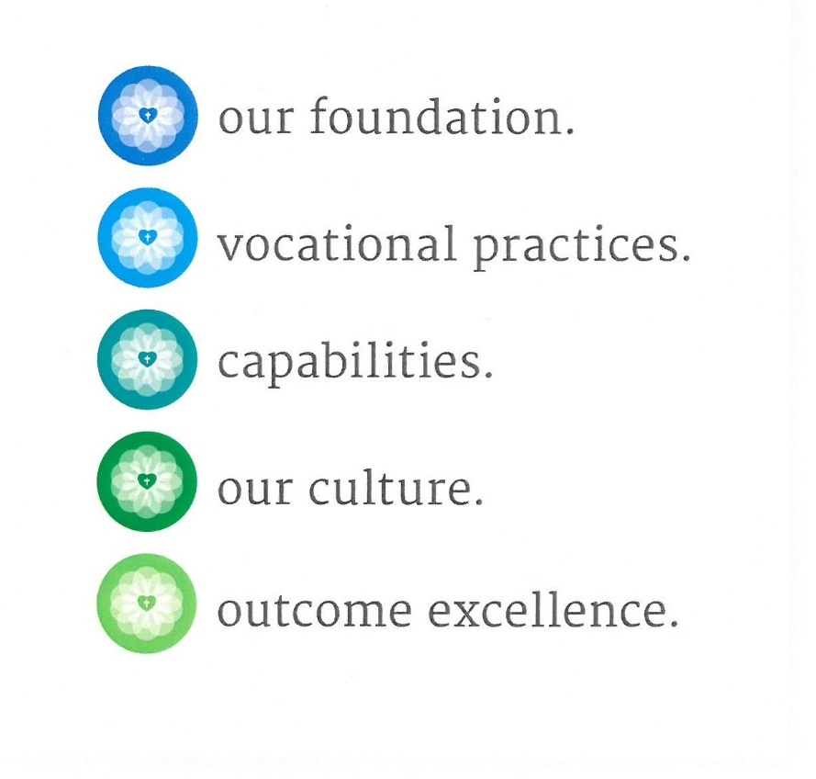
Notes:
We have explored the concepts of leadership and formation. We will now look at the five elements of Growing deep.
Our foundation is at the heart of Growing deep and is the lens through which all is seen.

Slide 26

Lutheran education draws upon Christian beliefs and values.
The following documents provide the lens through which we view all that occurs within a Lutheran school or early childhood service.
The Lutheran lens
Supporting policies and documents:
The LCA and its schools
Vision for learners
The Lutheran schools as a place of mission and ministry
Notes:
Lens of Lutheran theology and spirituality washes through all that we do.
The systems documents will be revised in relation to Growing deep.

Slide 27
Neville Grieger introduces the Lutheran lens

Slide 28
Growing deep – Our foundation
Notes:
Provide time to read.

Slide 29
The Lutheran lens
Reflect on one of the theological statements.
If your community valued the statement, what evidence could be gathered?
Think about evidence in curriculum, policies, strategic plan, etc
Notes:
Form groups of three and choose one of the statements in the Lutheran lens.
Tasks
Option1
Ask them to develop a Y chart to record what the statement might look like, sound like and feel like in practice. Think about specific implications for curriculum, policies etc. Share and discuss the statements.
Option 2
Reflect on one of the statements. Discuss and record: If your community valued the statement, what evidence could be gathered?
Share with the participants how the Lutheran lens washes through the framework and all that we do in our schools or early childhood services.
It is not an extra layer.
It is not a wedge in a cake.
It is a 24/7 thing. It is our very being and way of looking at and conducting education.

Slide 30
Lutheran schools are communities which recognise the brokenness of humanity and yet are places where grace abounds, reflecting the unconditional love of the Father, revealed through the saving work of his Son, Jesus.
Pathways: spiritual focus – God’s story God’s message
Pathways: theological focus – Freedom encounter
Equip – Module 1,2, 5,10
Christian Studies Curriculum Framework – Christian beliefs
Vision for learners – A framework for Lutheran schools
Leadership Development Program – Education and theology in dialogue
Notes:
Provide slide to show connection. These courses can and will be aligned to Growing deep.

Slide 31
How could you see the Lutheran lens being used throughout the career journey of staff?
(induction, first year, 2-5 years, 5-10 years etc)

Slide 32
The website resources and links

Slide 34

Core areas of work – ‘What’ leaders do…
Excellence in learning
Ongoing improvement and innovation
Strengthening Lutheran identity
Community building
Leading effective organisation and management
Notes:
Vocational practices describes the work we all do in Lutheran education. These have been developed using the AITSL principals standards as the basis and then refined through the consideration of a number of other leadership frameworks.
Provide time to read.

Slide 35

How do the explanations and Vocational practices descriptors speak to you and your role?
2. How could you collaboratively use these to continue to grow as a high performing team?
Notes:
Shane

Slide 36
Notes:
The capabilities describe how we do what we do in Lutheran education. This is the area that draws heavily upon the consultations and work of Atkinson consulting!

Slide 37

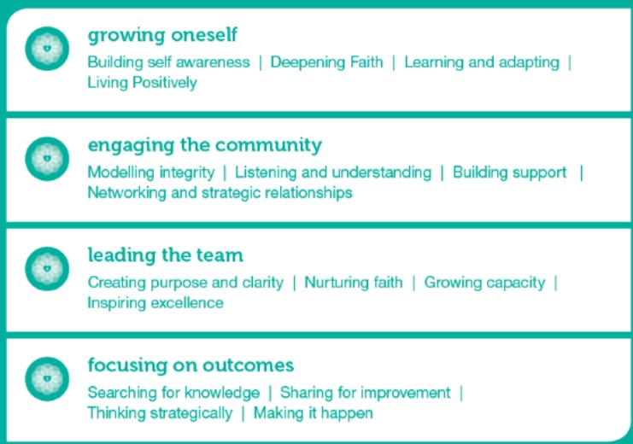
Capabilities, descriptors – “HOW” leaders do what they do
Notes:
The Capabilities are sorted into four areas: Growing oneself, engaging the community, leading the team, focusing on outcomes.
Each of these areas has four categories.

Slide 38
Growing oneself
Capabilities:
Building Self Awareness
Involves building an understanding of oneself - being ‘in tune’ with ones own biases, assumptions, thoughts and feelings and having an awareness of how these impact our decision making capacity or how one presents to others. It includes the capacity to control or suspend one’s own thoughts, emotions and judgements and be comfortable in ambiguous or stressful situations without making reactive decisions or jumping to irrational or emotive conclusions.
Deepening Faith
Expresses itself in a practice of service to others and to God and provides a framework for making meaning, developing identity and relationships. It includes witnessing to the Christian faith as one walks a spiritual path with Jesus and recognising God's presence in daily experiences and the importance of faith in both joyous and challenging times. At its highest it involves a deep understanding and application of Lutheran theology that truly exemplifies “law and gospel” in action.
Learning & Adapting
Is the desire to learn and grow in one’s chosen professional vocation. It includes being open-minded to new information and feedback from others, objectively considering other interpretations and demonstrating a readiness to adapt one’s thinking and practice in order to improve. At its highest, it involves the capacity to transform one’s habitual mental and emotional patterns. This includes consciously choosing alternate way of thinking, feeling and acting that best serve us in reaching our highest potential as leaders in Lutheran Education.
Living Positively
Is the ability to maintain a positive outlook or perspective, even in the face of obstacles or setbacks. It includes being optimistic about the future, and consciously choosing to project warmth, faith and hope in the guidance of God. It involves valuing the contributions of all and creating an sense of optimism by building a positive and energetic climate of encouragement and support, even during times of difficulty or change.
Notes:
If we consider the capability of Growing oneself, you can see the four ways in which we can do this.

Slide 39
Growing oneself
Capabilities: Building Self Awareness
Involves building an understanding of oneself ­ being ‘in tune’ with one’s own biases, assumptions, thoughts and feelings. It is having an awareness of how these impact our decision making capacity or how one presents to others. It includes the capacity to control or suspend thoughts, emotions and judgements and be comfortable in ambiguous or stressful situations without making reactive decisions or jumping to irrational or emotive conclusions.
Descriptors
Aware of one’s own thoughts and feelings: Is conscious of and pays attention to one’s thoughts and feelings. Is aware of how one is listening, speaking or acting, and is conscious of personal biases and assumptions. Can observe patterns in one’s thoughts and feelings and is aware of how to respond as a consequence.
Aware of impact: Is aware of and recognises how patterns of thinking, feeling and behaving impacts on oneself and others. Understands both the positive and potentially damaging impact that emotions and behaviour can have on others, including colleagues, staﬀ, other professionals, students and parents. Understands when one’s thoughts or emotions are biasing on decision-making capacity.
Controls & manages emotions: Controls outward expression of emotions and feelings. Projects a calm, controlled and clear-headed demeanour, even under conditions of high stress. Has the capacity to masterfully maintain composure and control.
Suspends judgement: Is aware of when one is judging rather than observing. Demonstrates the capacity to ‘suspend’ observations without immediately judging or categorising what we see or hear. Calmly ‘holds’ anxiety, risk and ambiguity, rather than jumping to irrational or emotive conclusions, or making reactive decisions as a way to ‘move on’.
Notes:
If we drill down further you will find that for growing oneself, in the area of building self awareness we have four descriptors that unpack the capability.
These descriptors are of increasing difficulty and complexity from one at entry level through to four.
This does not mean that principals will be at level four and beginning teachers at level one.
Stephen Atkinson has suggested that if everyone operated at level one then we would have a high performing system.
Use the Growing oneself self reflection tool to engage the participants with the capabilities.

Slide 40
Cain McDonald shares how the capabilities could be used.

Slide 41
Capabilities, descriptors – “HOW” leaders do what they do
Skim through the capabilities and descriptors.
Read the Growing one self explanation and descriptors.
How could you see this being used
individually
in your team?
Notes:
Discuss comments from PPT question.
Ask each pair to identify one way they would like to see it being used.

Slide 42
Notes:
If we have clearly identified vocational practices and are all developing our capabilities then we can create a healthy workplace culture.
What does that look like in Lutheran education?
Workplace culture is defined as the atmosphere or climate of the work environment. It is the perception of how it feels to work in Lutheran Education, within a particular location, office, school, team or for a specific leader. It is the ideal operating environment required to provide a working climate that will enable people to work sustainably at their highest potential.
Workplace culture effects organisational effectiveness. An unmanaged culture is likely to result in lower levels of motivation and, at times, cynical and disenchanted individuals providing minimal contribution. A positive work culture results in higher levels of motivation and effort from the people within that team or unit or school, and has been shown through research to drive higher levels of effectiveness and productivity.

Slide 43
Lutheran education workplace culture
Leadership and Culture
Workplace culture plays a critical role in influencing the behaviour of the members of an organisation and the outcomes it produces, the demonstrated capabilities and behaviour of leaders plays a particularly vital role in creating and shaping the culture.
The diagram represents the powerful inter-relationship between capabilities, culture and outcomes for Lutheran Education. The ‘loop’ acts to reinforce either positive or negative outcomes.
Capabilities
Culture
Outcomes
Notes:
If culture is the way we do things around here. Then having a positive and productive workplace culture is critical in being an effective school or ECC.

Slide 44
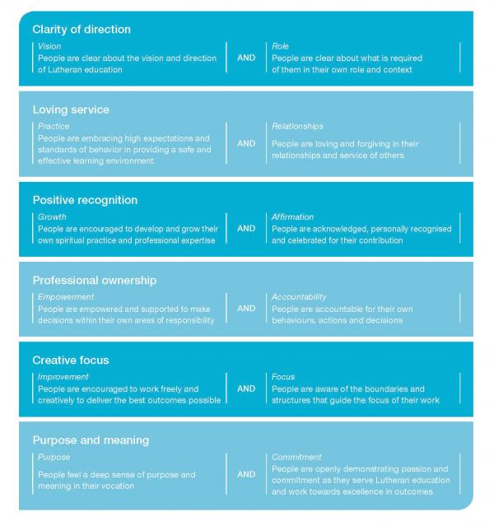
Lutheran education workplace culture
Notes:
During the consultations across Australia, Stephen Atkinson asked Lutheran educators what helps make Lutheran education effective and these workplace cultural attributes were identified.
The most important word on this page is AND as we need both of these attributes in each of these areas, eg for clarity of direction you need both vision and role.
You can have a great vision for your classroom or school or kindy but if everyone involved in this place does not have clarity about their role in helping realise the vision then it is unlikely that the direction will be achieved.

Slide 45
AND
OR
OR
Notes:
The task: Take one of the cultural elements and develop a matrix to consider what you might see in the workplace if these elements were not able to flourish together in a way where both can be equally strong and effective.
People are empowered and supported to make decisions within their own areas of responsibility
Empowerment is the process of enabling or authorizing an individual to think, behave, take action, and control work and decision making about her job in autonomous, independent, self-directed ways. It is the state of feeling self-empowered to take control of your own destiny.
Empowerment is feeling in control of your work environment and that you have permission to make decisions in the areas you control and are responsible for in your job.
People are accountable for their own behaviours, actions and decisions
Accountability means being answerable for decisions and having appropriate mechanisms in place to ensure standards are applied or adhered to.
Accountability is often used synonymously with concepts such as responsibility, answerability and liability.
What is people were only empowered…. What might you see?
What if people were highly accountable for all that they did? … What might you see?
What would you see if people were accountable and empowered?
See website for task cards.

Slide 46
Notes:
The Lutheran lens through which we view education, the what and how we do it create a healthy workplace culture that enables us to create excellent outcomes.

Slide 47

Excellence in learning
Staff and students are engaged, self-directed learners with purpose.
High expectations and opportunity to achieve and extend beyond perceived personal potential is provided through a differentiated and individualised approach to learning.
Improvement and innovation
A culture of risk taking and creativity is nurtured and fostered.
Strengthening Lutheran identity
Rituals, symbols practices and built environment convey the Christ centred identity of the school.
Community building
A culture of collaboration, reflection and action empowers the community.
Effective organisation and management
Resources, policies and processes enable staff and students to thrive.
Notes:
The excellence in outcomes page will be co-constructed this year as schools and early childhood service engage with Growing deep. It will grow and be shaped as we consider this across Australia.
It is thought it might have an overarching outcome that could be the outcome for staff and students in Lutheran education.

Slide 48
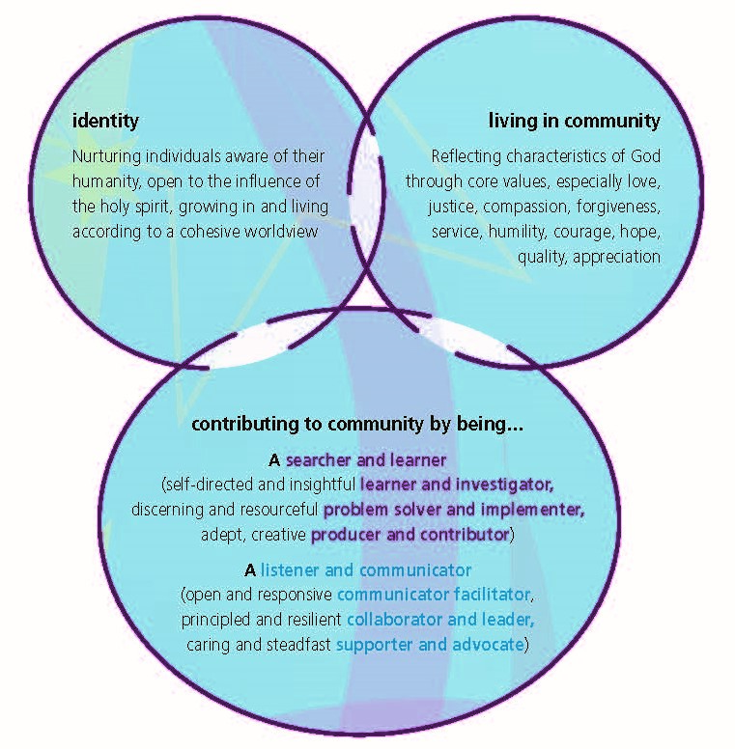
A vision for learners and learning in Lutheran schools
Notes:
The Vision for learners and learning in Lutheran schools provides descriptions of excellence in outcomes for students. However Sue Kloeden, retired LEQ Executive director, has suggested that this could be an excellent outcome for staff as well.
This could provide a starting point for you to consider excellence in outcomes.

Slide 49
Dr Loyd Fyffe shares the purpose of Excellence in outcomes – video

Slide 50
Trialling and feedback
Trialling schools
Feedback
Growing deep encapsulates Lutheran education
Growing deep provides a common base and language for Lutheran education which each school or early childhood service can bring to life in their own context
The comprehensive nature and richness of Growing deep was highlighted
Principals liked being able to choose which area was most relevant and the starting point for their staff

Slide 51
Angela Branford shares how she will use Growing deep – video

Slide 52
Principals suggested using Growing deep to:
develop role statements for staff
provide structure to the principal report to school council
develop their school or early childhood service outcomes/vision/strategic plan
support staff in their professional reflection and goal setting
grow the theological understanding of executive teams and staff
focus and provide a common language to school or early childhood service documentation/policies
to reflect on how culture impacts on student outcomes
consider what excellence in outcomes looks like in their school or early childhood service
Notes:
Ask principals who were involved in the trial to share either how they have used Growing deep or how they intend using it.

Slide 53
Applications for Growing deep
Applications used in the trial
  Role statements
  Staff discussions
  Under development
Quality schools
Capability and work culture index Atkinson Consulting!
Teacher reflection tool through ACU Janeen Lamb
Notes:
If you would be interest in these applications please contact your Regional Executive Director or Anne Dohnt at LEA.

Slide 54
Roll out
Each school or early childhood service will give expression to Growing deep in ways that reflect their context.
Work with your team to discuss how you will introduce Growing deep
Notes:
Time to discuss: what next?
How will Growing deep connect with other things they are doing at the school or early childhood service?
After 30 mins ask schools groups to mix and share their ideas with someone from another school or early childhood service.

Slide 55
Growing deep in our context
What projects are we engaged in right now that could be informed or shaped by Growing deep?
What parts of Growing deep do we need to attend to in our school or early childhood service as a priority?
How might we introduce this framework to staff at our school or early childhood service ?
How might Growing deep connect to other pieces of the puzzle at our school or early childhood service ?
What concerns may staff have and what concerns do I have?
How might we deal with these concerns?
Notes:
These questions can guide your thinking about how Growing deep can support your school or early childhood service initiatives.

Slide 56
Where to next?
Regional office support – delivery
LEA support – resourcing
Notes:
Ask the group to list: How can LEA and the regional offices support you?
Use the handout with the following information;
School or early childhood service name:
Where will you start with Growing deep?
Possible support at regional level (delivery)
Possible support from LEA (resourcing)

Slide 57

It is time to stop waiting for someone to save us. It is time to face the truth of our situation – that we’re all in this together, that we all have a voice – and figure out how to mobilise the hearts and minds of everyone in our workplaces and communities.
Margaret Wheatley, 2010
Notes:
Close

Slide 58

I used to think….
Now I think…

Slide 59
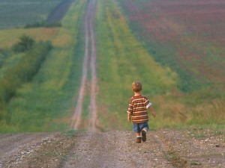
Benediction
(based on Psalm 105:4, 7-8, The Message)
As you go from here into the days ahead,
Keep your eyes open for God,
watch for His works;
be alert for signs of His presence.
For He is God—our God—
in charge of the whole earth.
And He remembers His Covenant—
for a thousand generations He’s been as good as His word.
So go with confidence and joy,
knowing that God goes with you.

