Slide 1
SIF School Improvement Framework
Notes:
This PowerPoint has been designed for Principals to work with their leadership team and staff. The aim is for you, as you journey through school improvement to adapt this PowerPoint for your own needs.

Slide 2
The SIF connects with:
LEA strategic plan
THEME 1: Strengthening Lutheran identity
THEME 2: Strengthening and celebrating thriving learning communities
THEME 3: Ensuring long term system sustainability
Notes:
The School Improvement Framework has been developed as a result of the LEA Strategic plan’s three themes.

Slide 3
The SIF also connects with:
LSA Strategic plan
LEVNT Strategic initiatives
LEQ Strategic plan
Notes:
The SIF also aligns with the regional strategic plans

Slide 4
Lutheran Education
The aim of the SIF:
A collaborative effort
LEA
Region
Region
School
Notes:
The aim of the SIF is to foster collaboration between regions, LEA and schools.

Slide 5
SIF – School Improvement Framework
History
aligned to other frameworks and government expectations
a starting point for LEA and regions to develop a system wide approach to school improvement
the basis for Quality Schools – the system data collection tool
Growing deep – leadership and formation framework
Notes:
Whilst currently the Minister has removed the mandate that asked for schools create a school improvement plan, we believe developing a school improvement plan aligned with Growing deep will be enormously beneficial for our system. This framework is derived from Quality Schools and provides another means of validating the data about your school.

Slide 6
SIF – School Improvement Framework
History
What does the data tell us about Lutheran schools?
BSP: Better Schools Project (2009, 2011, 2013)
QS: Quality schools (2016)
NAPLAN (2009-2016)
Notes:
Nationally there have been three forms of data collection that has been analysed - the Better Schools Project data over three iterations, in 2009, 2011 and 2013, - the Quality Schools data collection of 2016 and the analysis of national LEA trends of the NAPLAN data.

Slide 7
SIF – School Improvement Framework
LEA SCHOOL HEALTH (from BSP and QS data)
Caring
Supportive
Upholding strong Christian values
Sense of community
Sense of belonging
However
Notes:
From the data it is clear that Lutheran schools generally are seen as caring, supportive, having a strong sense of belonging and community. There is a belief that Lutheran schools also hold strong Christian values and this is seen as favourable.

Slide 8
SIF – School Improvement Framework
BSP 2009 - 2013 National trends:
Staff
Classroom/ Student misbehaviour
Individual / School distress
Work demands / Appraisal and recognition
Students
Classroom behavior
Stimulating learning
Enthusiasm
Parents
Classroom behavior
Extra-curricular
Homework
Parent input
Notes:
However, the data also highlights some issues of concern.
There have been some trends nationally which started with the Better Schools data and continues through to the Quality schools data.

Slide 9
SIF – School Improvement Framework
QUALITY SCHOOLS (QS) 2016
STAFF -Teaching quality (student behaviour) -Professional learning (feedback on performance) -Teaching quality (timetable) | STUDENT (Secondary) -Teaching quality (learning engagement/ quality / enjoyment) -Teaching quality (student behaviour) -Religious identity, culture & ethos (Christian practices / Gospel values) | STUDENT (Primary) - Teaching quality (Student behaviour) -Teaching quality (learning) -Wellbeing (Respect) | PARENT -Teaching quality (Student behaviour) -Teaching quality (Teacher feedback about children’s learning) - Teaching quality (Children’s involvement in learning decisions)
Notes:
The Quality Schools data clearly indicates that teaching quality is of concern. This began with the BSP and the QS reinforces this belief.

Slide 10
SIF – School Improvement Framework
NAPLAN
Analysis of NAPLAN results 2008-2015 - Dr Juhani Tuovinen
Most urgent priority areas:
Persuasive writing in years 9, 7, 3, and 5 for LSA
Persuasive writing in years 7 and 9 for LEQ and LEV
Narrative writing in years 7,9, and 5 for LEV
2. Numeracy in years 3 and 7 for LSA and LEV and year 7 in LEQ
3. Spelling in years 9,3 and 7 for LSA and reading in year 9 for LSA
Notes:
Additionally, the national and regional NAPLAN data, compiled by Dr Juhani Tuovinen, pinpoint some urgent concerns.

Slide 11
SIF – School Improvement Framework
LEA SCHOOL HEALTH
Whilst Lutheran schools are highlighted as sound, caring, Christian schools that build and nurture community…
The quality of teaching and learning is of concern for our Lutheran schools nationally
This trend began with the BSP and continues with QS
NAPLAN data voices similar concerns

Slide 12
SIF – School Improvement Framework
BLEA REPORT - WHAT NEXT WITH QUALITY SCHOOLS?
WHERE TO FROM HERE?
Board for Lutheran Education Australia directive:
To create a LEA School Improvement Plan template that aligns with Growing deep
Engage schools to pilot the template
Post on the LEA website for schools to choose to use
A national example
Notes:
As a result of the QS and BSP data analysis the Board for Lutheran Education Australia directed LEA to create a school improvement plan that aligns with Growing deep, to engage principal leaders to write the document, engage schools to ‘pilot’ with the purpose of having a robust national school improvement framework for schools to use.

Slide 13
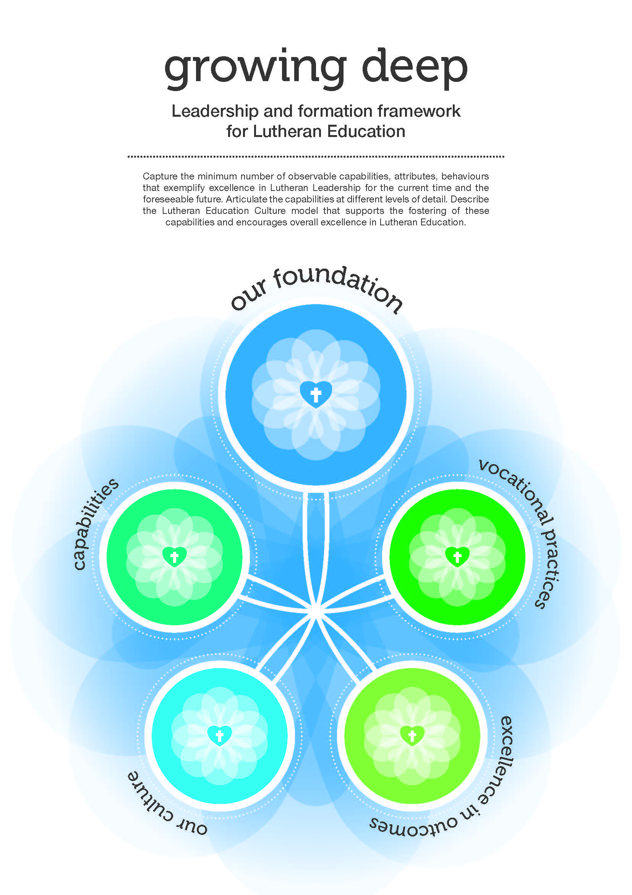
Notes:
Growing deep has five elements.
The Vocational practices provided the basis for the development of the Quality schools survey.
The LEA Assistant Director Leadership, the 2015 regional assistant directors and a principal from each region were responsible for the development of the Quality schools survey tool.

Slide 14
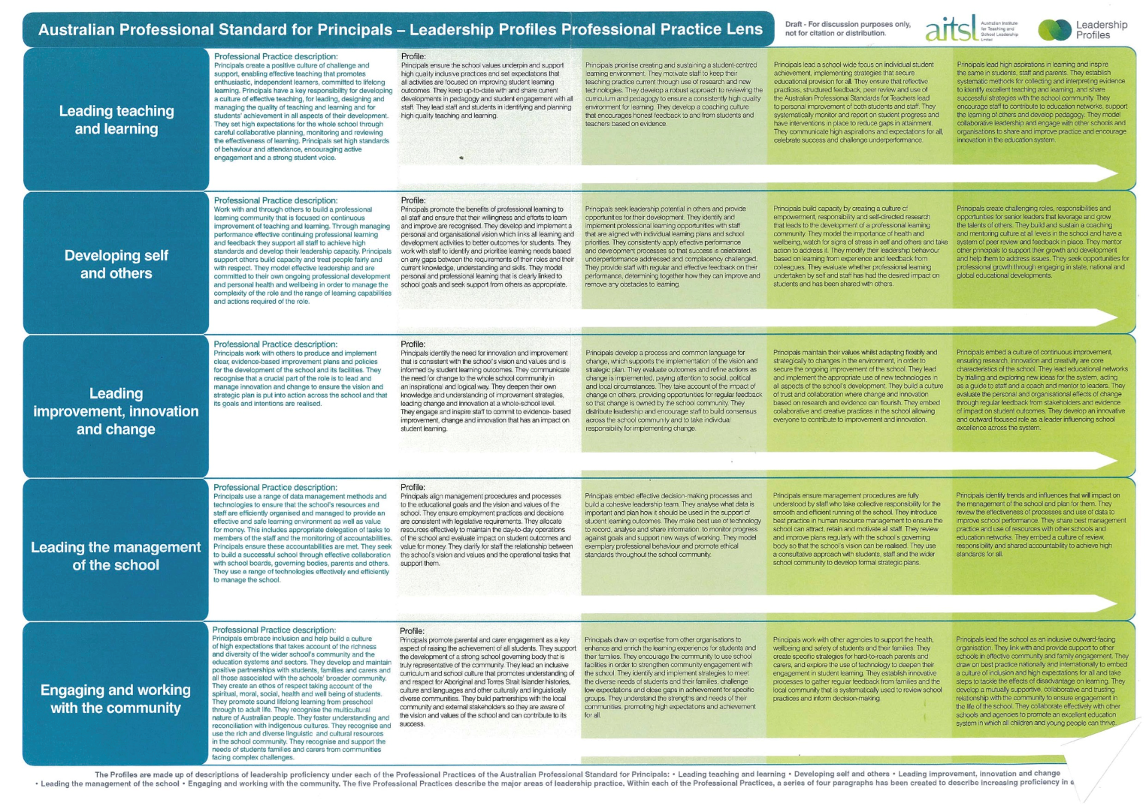
Leadership and formation framework for Lutheran education
Capabilities – “HOW” leaders do what they do
Our Foundation
Growing
oneself
Engaging the community
Leading the team
Focusing on outcomes
Our workplace
culture
Excellence in outcomes
Excellence in learning
Building self awareness
Deepening faith
Learning and adapting
Living positively
Modeling integrity
Listening & understanding
Building support
Networking & strategic relationships
Creating purpose & clarity
Nurturing faith
Growing capacity
Inspiring excellence
Searching for knowledge
Sharing for improvement
Thinking strategically
Making it happen
Ongoing improvement
& innovation
Strengthening
Lutheran Identity
Core Areas of Work – “WHAT” leaders do
Community
building
Leading effective organisation
& management
Notes:
The brief for Growing deep was that it would build upon existing frameworks such as the AITSL Professional standards for principals.
This graphic describes the way in which Growing deep has been organized.
1. Our foundation describes the Lutheran lens through which we see education.
2. The Vocational practices describe the work we all do in Lutheran education. The Vocational practices reflect the professional standards for principals as can be seen in this graphic developed by Atkinson Consulting! who conducted the consultations with leaders of Lutheran education across Australia.
3. The Capabilities describe the way in which we work or ‘how’ leaders do what they do.
4. All of this needs to be supported by a workplace culture that reflects the Lutheran lens but also enables excellence in outcomes for students and staff.
5. Growing deep is designed to support Lutheran education achieve excellence in outcomes for students and staff.

Slide 15
Leadership and formation framework for Lutheran education
Capabilities – “HOW” leaders do what they do
A vision for learners and learning in Lutheran schools
LCA and its schools
Our Foundation
Excellence in outcomes
Growing
oneself
Engaging the community
Leading the team
Focusing on outcomes
Our workplace
culture
Excellence in learning
Building self awareness
Deepening faith
Learning and adapting
Living positively
Modeling integrity
Listening & understanding
Building support
Networking & strategic relationships
Creating purpose & clarity
Nurturing faith
Growing capacity
Inspiring excellence
Searching for knowledge
Sharing for improvement
Thinking strategically
Making it happen
Ongoing improvement
& innovation
AITSL professional standards for principals
Strengthening
Lutheran Identity
Vocational practices – “WHAT” leaders do
Community
building
Pathways
Leading effective organisation
& management
Equip
AITSL professional standards for teachers
Notes:
Growing deep was also designed to be the basis for the work of Lutheran education, providing connection and a common language to the various programs offered for principals, teachers and staff.
LEA policies and programs will undergo review in light of Growing deep.

Slide 16
SIF – School Improvement Framework
The process:
A SIF writing group was formed that included three principals from each region and a regional representative
A range of documents were studied including:
QASF Quality Adventist Schools Review and Improvement Framework
ACER National School Improvement Tool
CIF Continuous Improvement Framework for Catholic Schools
Various state and regional improvement guides

Slide 17
SIF– School Improvement Framework
The process:
The SIF writing group met
Two 2-day workshops were held to begin the process:
To determine school needs – If a SIF was created what were the
key factors to consider?
Notes:
Two groups of principals and leaders met to begin the writing process. Each group met for two days, after which the current document was created.

Slide 18
SIF– School Improvement Framework
The process:
Key factors:
A focus on growth and improvement
A consistent Lutheran sector approach
Student centred with a focus on quality student learning
An standardised accountability tool
A cycle of ongoing improving and growth
Notes:
The group wanted these factors to be considered

Slide 19
SIF– School Improvement Framework
The process:
The SIF writing group process:
How do we go about creating a document that will support Lutheran
schools work towards school improvement in their workplace?
What is needed in this document?
Notes:
These were the questions identified by the groups

Slide 20
SIF– School Improvement Framework
Growing deep vocational practices
VOCATIONAL PRACTICES (VP):
Excellence in learning
Ongoing improvement and innovation
Strengthening Lutheran identity
Community building
Leading effective organisation and management
What are the indicators of effectiveness (fundamentally important aspects) under each of the VP elements that Lutheran schools need to address to give direction to school improvement?
Notes:
It was determined that the five vocational practices would be used as the main headings and

Slide 21
SIF– School Improvement Framework
The process:
These indicators of effectiveness will help schools to know:
How we are going
How we know
How we move forward for improvement
What is the evidence that schools can use to determine
the above?
Notes:
From there elements under each as well as indicators of effectiveness and evidence were determined.

Slide 22
SIF– School Improvement Framework
The process:
The SIF rubric / rating scale
The SIF team considered a rating scale:
- How many levels?
- What are the descriptors?
- What are our priorities? (What does the data suggest?)
- What else do we include?
Notes:
A rating scale of four was suggested

Slide 23
SIF– School Improvement Framework
Where to from here?
Send out to pilot schools to use and provide feedback
Continue the process in 2017 using the feedback from the pilot schools
Build a useful, easy to use and informative school improvement tool for Lutheran schools across Australia
Notes:
To complete the stage 1 process it was suggested the pilot schools would take the first draft and review, add to the document for their needs and provide feedback to LEA.

Slide 24
SIF – School Improvement Framework
Where to from here? The role of the pilot school:
Choose an element/s of the Vocational Practices that your school would like to work on in 2017
Consider the listed indicators of effectiveness – are they appropriate / useful / complete? Adapt for your school and individual context
Consult with stakeholders as appropriate
Provide feedback to LEA with advice for improvement and additions to the document that your school has created
Notes:
It is hoped that the pilot schools will now take this document, review the indicators of effectiveness and make changes accordingly. We are also keen for schools to write descriptors under each rating scale so that schools can gauge the effectiveness of their school under each indicator. LEA acknowledges that this document is in early draft form and will go through many changes before the final product is ready for all LEA schools.

Slide 25
Thank you in anticipation for your support through this process The SIF writing team

